Slide 1
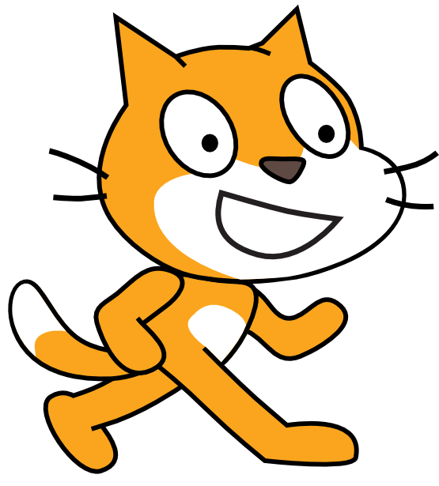
Scratch
Visual Programming
with Cats

Slide 2
Tourist Cat

Slide 3
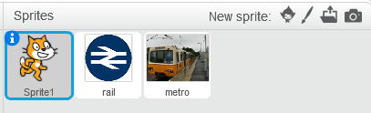
Remember our Tourist?

Slide 4
What does this
program … do?

Slide 5
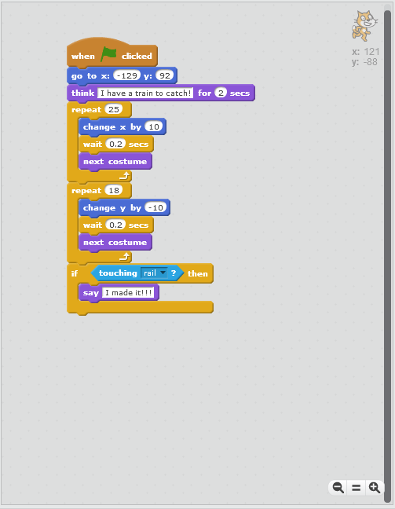

Slide 6
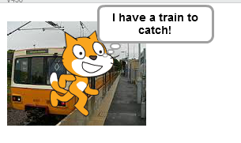

Slide 8
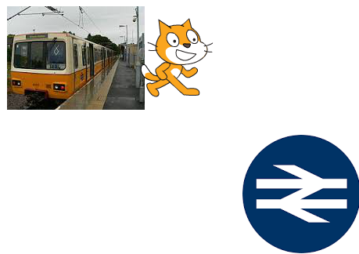

Slide 10


Slide 12
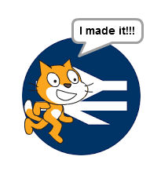

Slide 14
Improvements?

Slide 15
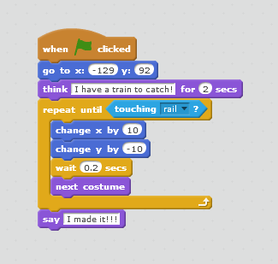

Slide 16
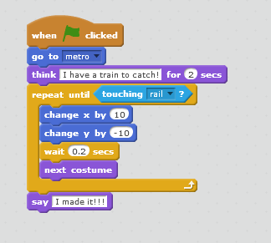

Slide 17
Can we make it
even better?

Slide 18
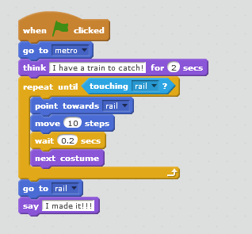

Slide 19
Your Turn…

Slide 20
http://scratch.mit.edu
Notes:
Go to website
There are versions you can download to your machine or you can get started really quickly using the website.

Slide 21
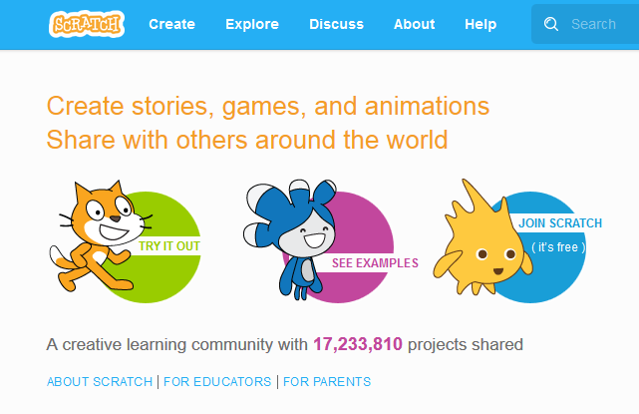

Slide 22
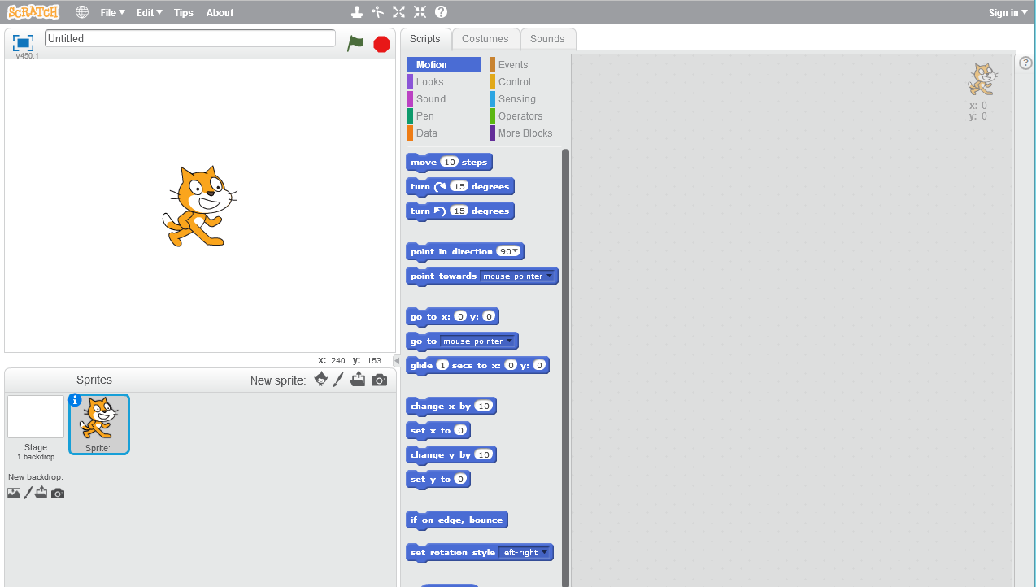
Notes:
The left hand side is where your program will run. The middle is set of **building blocks** you can use to
build the program (Scripts). Right hand side is where you drag the blocks and wire them up.
Note the Start and Stop buttons at the top.

Slide 23
A Bold Claim…
Notes:
I feel quite proud that I have managed to devise the **worst game in the history** of computer games and because I am so proud, I would like to share it with you and have you build it with me.

Slide 24
The Pitch
I want to write a game where the scratch cat:
1. moves on it’s own in a realistic way
2. follows the mouse
3. tries to catch the mouse
4. scores points for catching the mouse
5. if it scores enough points, the game is over
Notes:
I want to write a game where the scratch cat plays with the mouse (puns!). The cat scores points for catching the mouse and if it scores enough points, the game is over. Pretty exiting huh?

Slide 25
Let’s make
a game

Slide 26
Move the cat
a tiny bit…
Notes:
From the **Movement** tab, drag a **move** block across to the right hand side and click on it with your mouse.

Slide 27
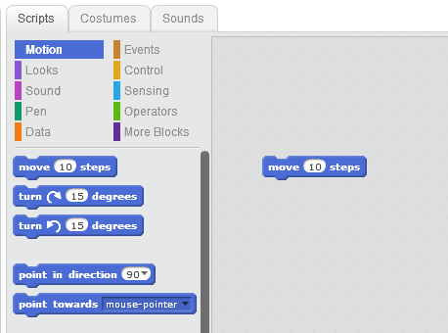
Notes:
You should see the cat move a little bit from it’s current position when you click on it and the block lights up.
Experiment with changing the value in the box. What happens?
What happens when you enter a negative value? Is that what you thought it would do?

Slide 28
More Movings?
Notes:
Switch to the Control section and drag a repeat block.

Slide 29
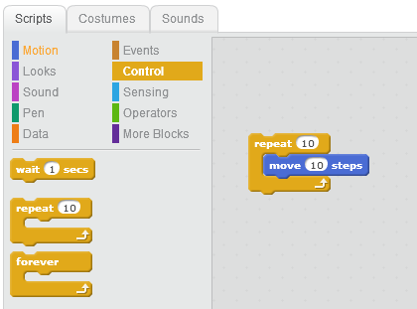
Notes:
Slide move into the repeat block, notice how blocks light up as you move them together. Click on the assembled blocks. What happens? Change the repeat value.
The repeat block surrounds the other block, implying that whenever that runs, the things inside it will run.

Slide 30
All the way across
the screen
Notes:
Let's make it walk all the way across the screen.
Pull movement block out and drag repeat block out. Drag on the forever loop and push two pieces together.

Slide 31
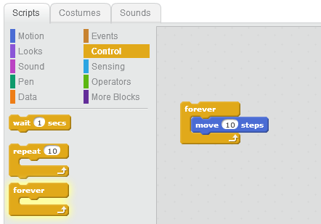
Notes:
Click on block - will go off screen and you can drag it back on but it will keep trying
to escape!!!
Lets try to correct that. Go to motion blocks and use if on edge, bounce.

Slide 32
Continuous
Movement

Slide 33
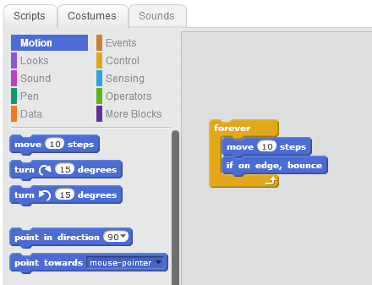

Slide 34
Our first BUG!
Notes:
Now it's upside down!
Look at bottom of page and right click on cat sprite.

Slide 35
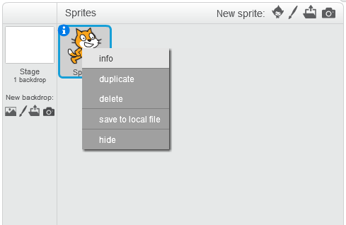

Slide 36
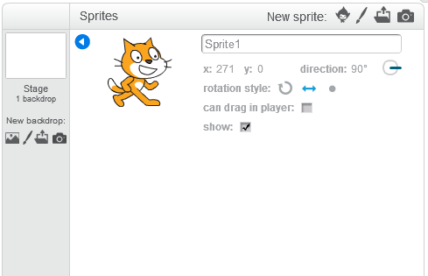
Notes:
Go to info on sprite and change rotation symbol to left right.
Now that it's behaving like we want let's try and make it more realistic. For a cartoon cat.

Slide 37
Animation

Slide 38
Repeat
Switch to Costume 1
Move 10
Wait 0.25
Switch to Costume 2
Move 10
Wait 0.25
Notes:
Our cat is showing a single costume at the moment. We can simulate animation by switching between two different costumes with a small delay in between each change.
Switch to **Looks** and drag on a **costume** block.

Slide 39
A Better Way?
Notes:
Use **Next Costume** and remove other blocks. This cycles through the available costumes.
Looks better?

Slide 40
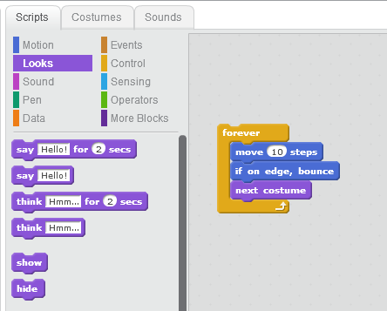

Slide 41
Game Events
Notes:
Clicking on the blocks to get the cat to do something is all very well but it's not what we want to see in the finished game. We want the cat to start running as soon as the game starts.

Slide 42
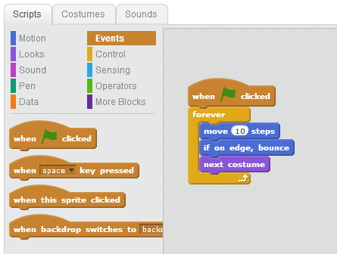
Notes:
Switch to **Events** and drag on a **When Start** and plug it into the top of the list of blocks.
We can make the game start when we click the green flag by adding an event to kick the process off. That way we don’t have to keep clicking on the blocks.

Slide 43
Following the Mouse
Notes:
Now we've got the mouse moving, let's try making it more like a proper (if really bad) game.
Let's try keeping the mouse moving and if the cat catches up with you, it scores a point!
Add **point towards mouse pointer** at end of blocks.

Slide 44
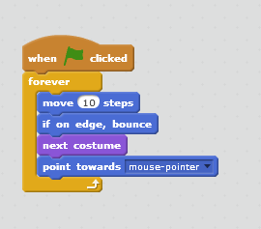
Notes:
So now the cat, follows you around the screen.

Slide 45
Here’s the Catch
Notes:
How does it catch you? We need to **test** where mouse pointer and cat are and do something if they are in the same place.
In **sensing**, there is a **touching** block. Drag the touching block onto our program. Notice it's a different shape and doesn't seem to fit with anything else. We need somewhere for it to go. Luckily there is somewhere for it to go. That is an if block. **If** s live in the **control** area.

Slide 46
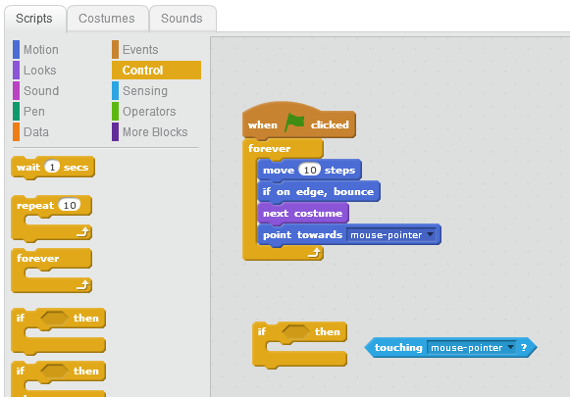
Notes:
Add If block (from control) and slot in the touching. Hinting that it will do something inside it when the sprite is touching mouse pointer? But what?

Slide 47
Keeping Score
Notes:
Make Variable from data. Score for this sprite only.

Slide 48
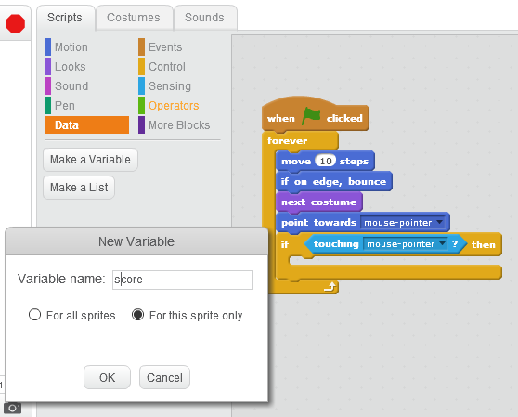

Slide 49
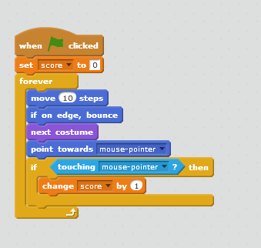
Notes:
Initialise at beginning before the game starts. If touching, change score by 1.

Slide 50
Making it fairer
Notes:
Cat catches us really quickly once it’s already got to the mouse. How about if we change it so that the cat resets to a random position and starts again?

Slide 51
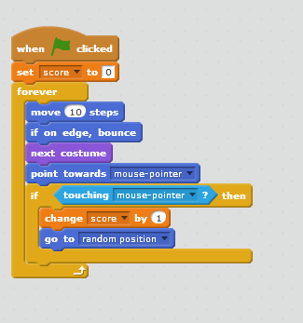

Slide 52
Finishing

Slide 53
End Criteria
New “Max Score” Variable
Set it at start
If…
Notes:
Now, what about if we get to a big value?
Let's put in a check to say we will end the game when we get to 50? If operators
comparison. Add MaxScore variable. Set it to 50 at start. If Score > MaxScore then end.
Stop this script.

Slide 54
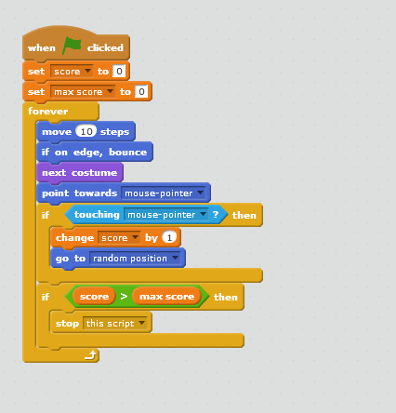

Slide 55
Did you spot
the mistake?

Slide 56
How can we make this game better (or worse)?

Slide 57
Next week?

Slide 58
Pong!
Let’s make a single player pong game
Bouncing Ball
Left-Right Paddle
Score
Finish

Slide 59

What steps do we need?

Slide 60

What steps do we need?

Slide 61
Steps
Move ball around the screen
Bounce on wall
Move paddle left and right
Bounce on paddle
Score
Background

Slide 62
Cats are Boring
Notes:
I'm tired of the scratch cat, so let's pick a new one from the library.
Delete the cat and select the new sprite.

Slide 63
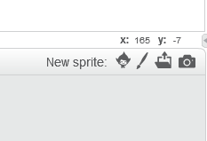

Slide 64
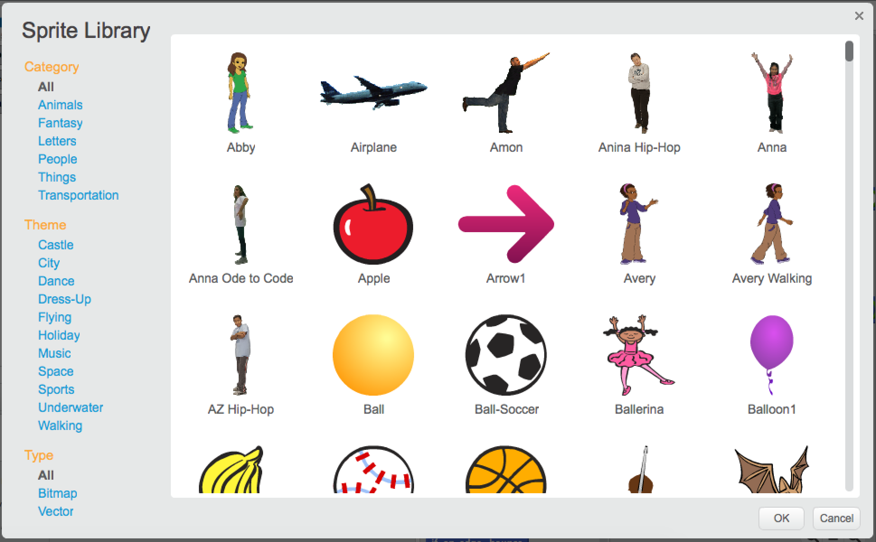


Slide 65
How do we start?

Slide 66
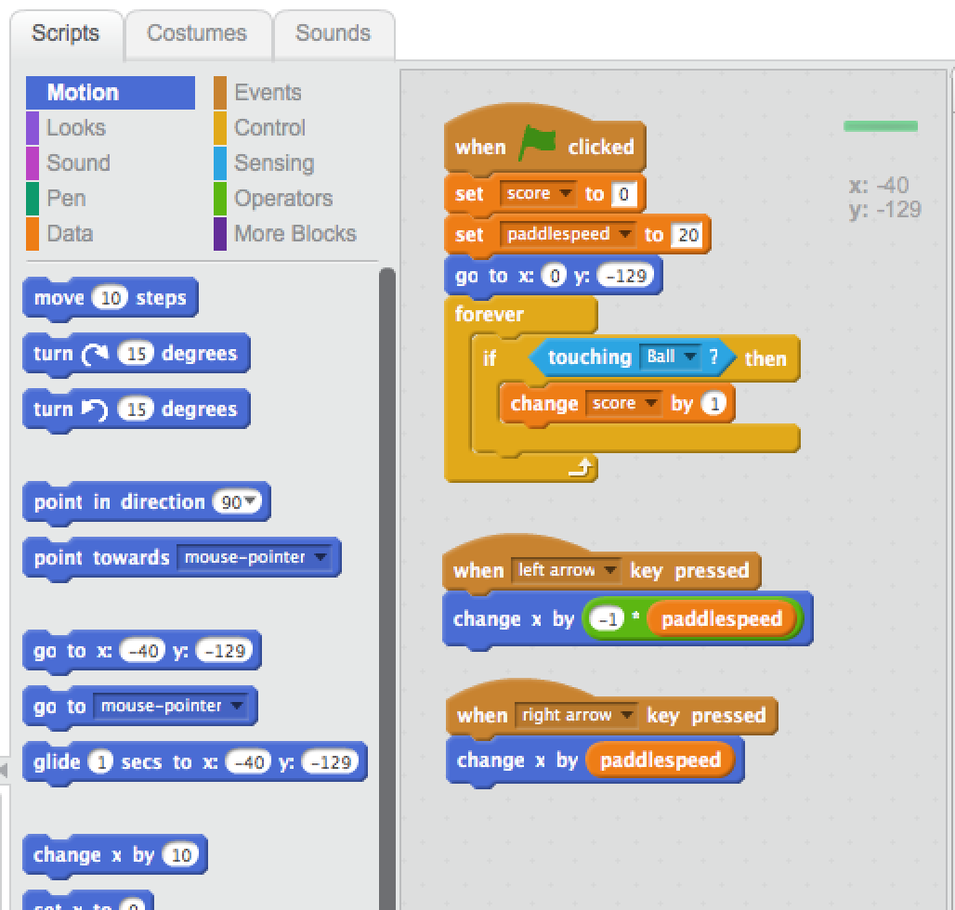

Slide 67
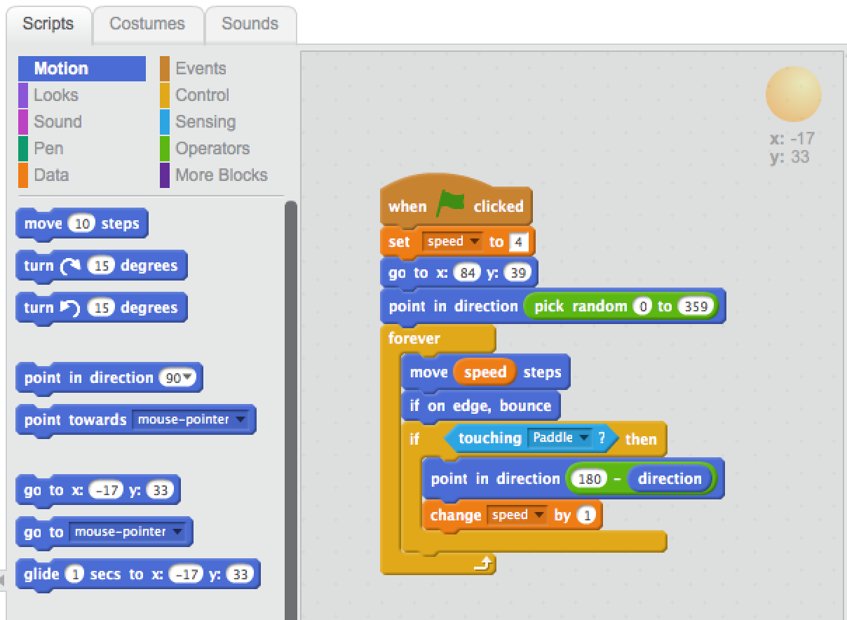

Slide 68
Extensions
How do we end the game?
What about a background?
Sound?

Slide 69
Another Bold Claim…
Notes:
Second worst game in the world, based on an internet meme.

Slide 70
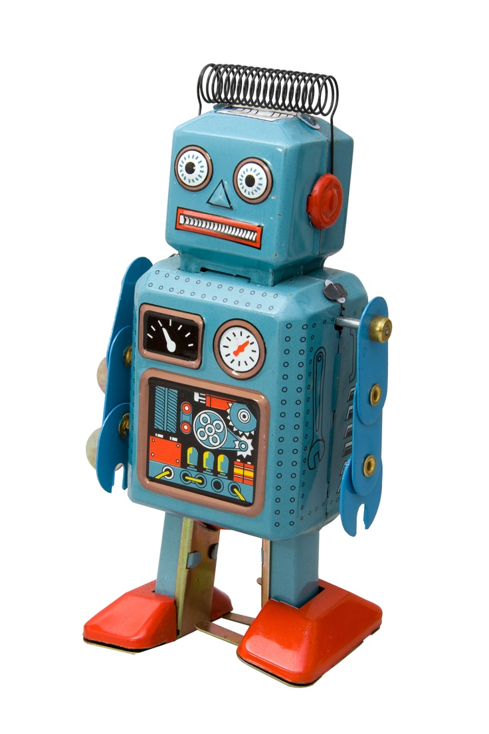
Kittens and Robots
https://scratch.mit.edu/projects/118819/
Notes:
Before we leave scratch, I'd like to share with you another one of my awful games.
This is a more complete game, I wrote a game with my oldest son a long time ago, based on an internet meme. Robot Finds Kitten which is available for x-box and playstation and lots of other platforms. The game uses terrible graphics and background colours by design and is meant to be among the most pointless available. You can play the game and look at the structure of the game here:
I didn’t invent this game but I did write the scratch version of it.

Slide 71
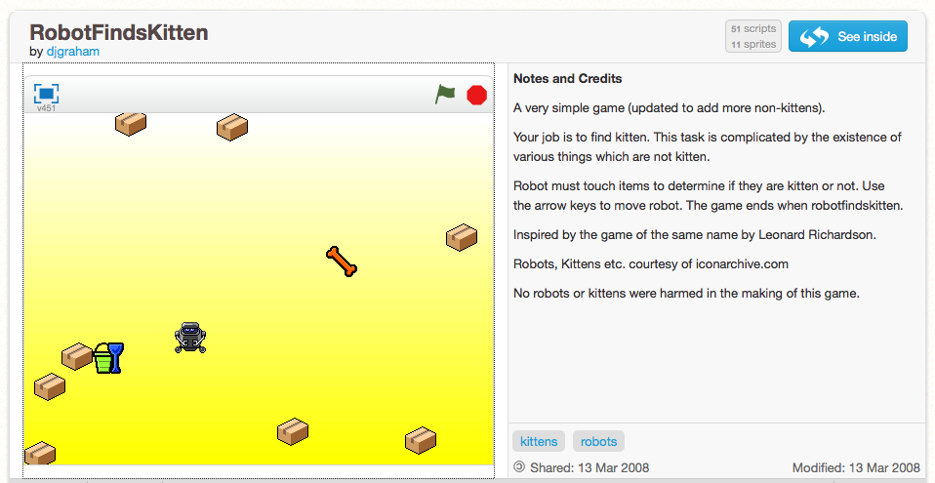

Slide 72
Community
Sharing culture
Support & Help
Application modes
See how an application works
Notes:
One of the best things about scratch is that it all projects on the site have two modes. One to run the game, but you can look at the internals (not something you can ordinarily do) and copy the project and adapt it yourself. Scratch is setup to support community and sharing.

Slide 74
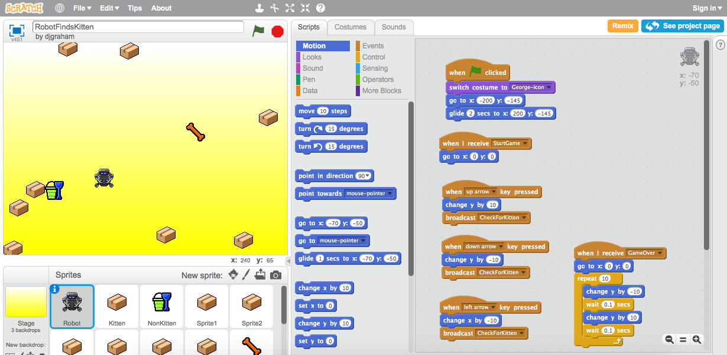

Slide 75
What have we learned?
• Decomposing a problem into smaller parts.
• Putting things in the right order - sequence
• Predicting Behaviour
• Selection - is it on an edge, is the game over?
• Repetition - forever blocks
• Variables - score, location, speed, colour
• Events - program start, end, mouse click, mouse move.

Slide 76
Questions?

Slide 77
Resources
Creative Computing Handbook
http://scratched.gse.harvard.edu/guide/download.html
Notes:
Raspberry Pi website has lots of good scratch material that is not RP specific.

